Slide 1


UNIVERSITY INSTITUTE OF ENGINEERING
COMPUTER SCIENCE ENGINEERING
Bachelor of Engineering (Computer Science & Engineering)
Subject Name: STATISTICAL METHODS USING R
Subject Code: 20SMT-460

Slide 2
Measures of Dispersion

Slide 3
Introduction:
Measures of dispersion quantify the extent to which data values deviate or spread out from the central tendency.
Dispersion complements measures of central tendency and provides insights into the variability or consistency of a dataset.

Slide 4
Common Measures of Dispersion:
1. Range
2. Quartile Deviation (Interquartile Range - IQR)
3. Variance
4. Standard Deviation

Slide 5
Usefulness of Measures:
Assess spread and consistency in data.
Identify outliers and extreme values.
Facilitate decision-making by understanding data variability.

Slide 6
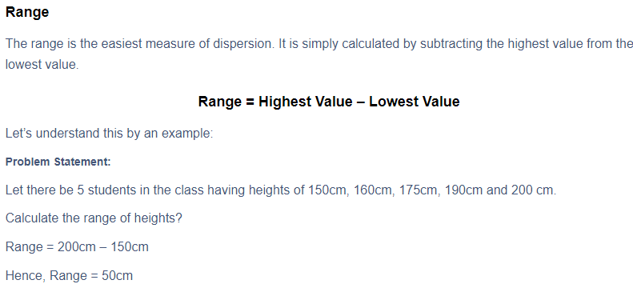

Slide 7
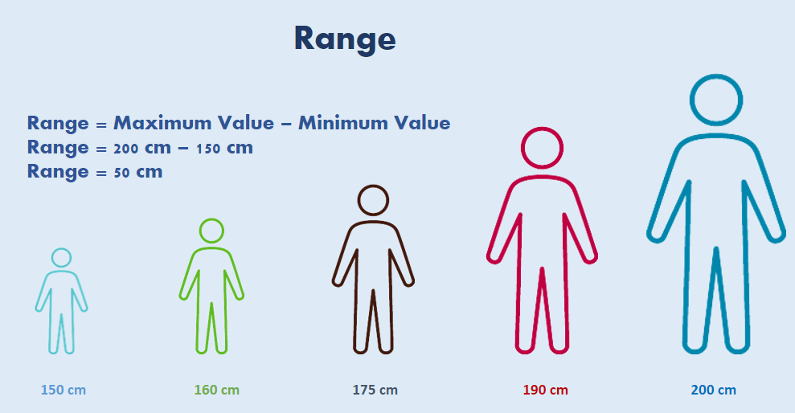

Slide 8
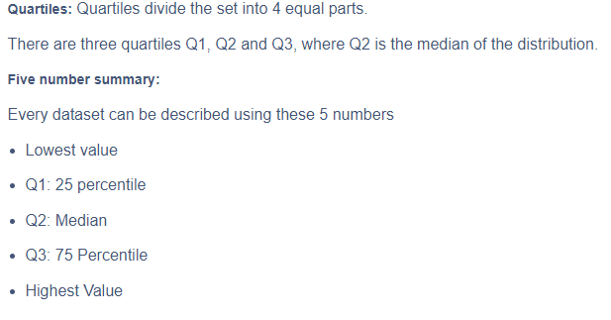

Slide 9
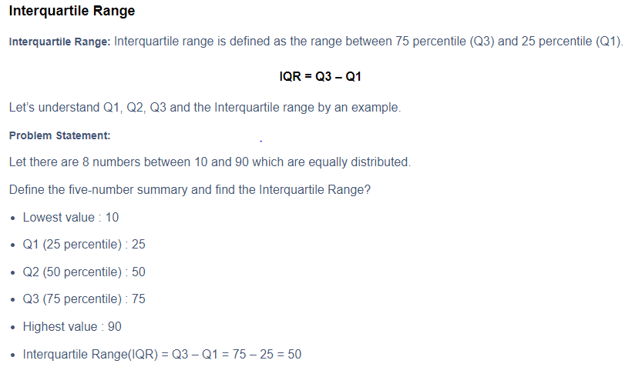

Slide 10
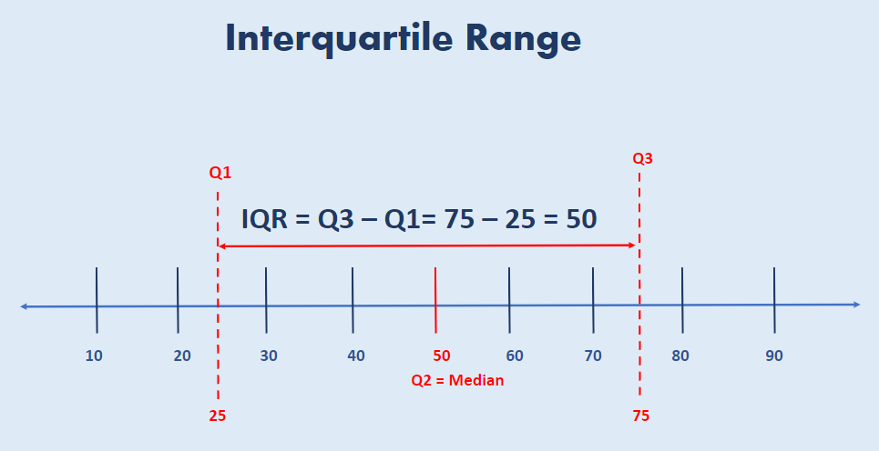

Slide 11
https://www.youtube.com/watch?v=E6jNADpaY2Q&pp=ygUvbWVhc3VyZSBvZiBjZW50cmFsIHRlbmRlbmN5IGFuZCBkaXNwZXJzaW9uIGlpdCA%3D

